Slide 1
Probability Theory
EAS 42000 / A4200
Lecture 03
October 6, 2025
Prof. Spencer Hill

Slide 2
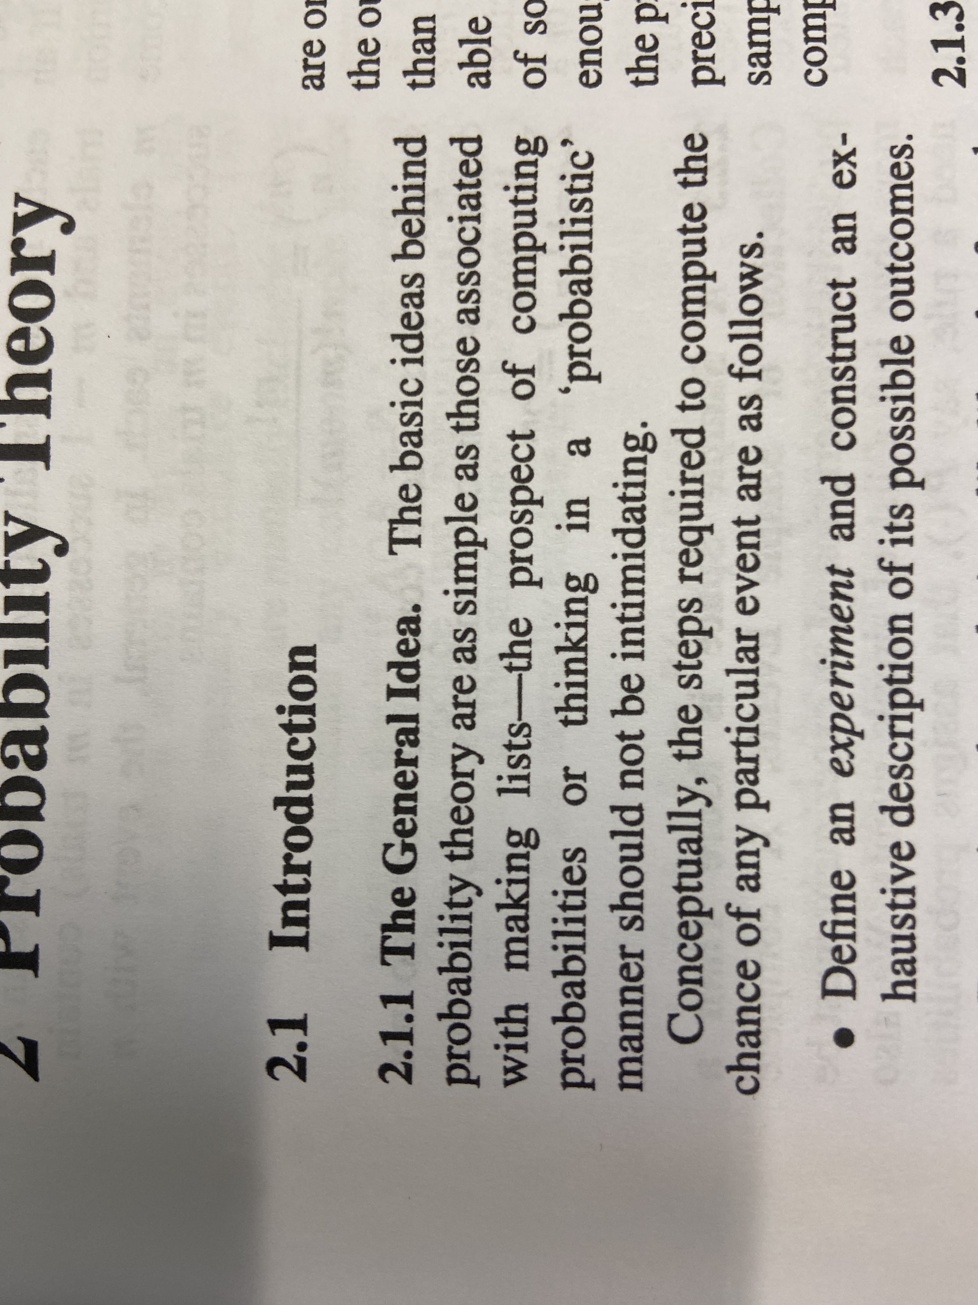
Probability theory is intuitive! Don’t be intimidated by the “theory” part
Opening to Ch. 2 of von Storch and Zwiers textbook. No pressure ☺

Slide 3
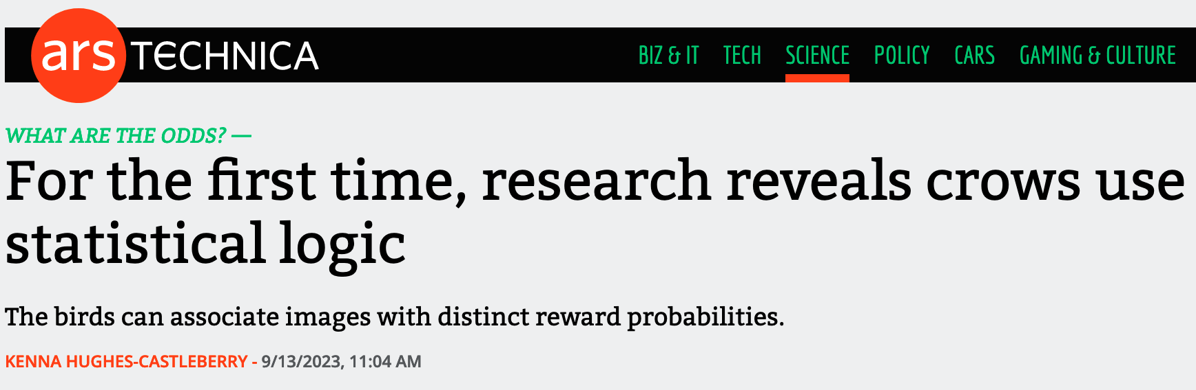

Probability theory is intuitive! Don’t be intimidated by the “theory” part
https://arstechnica.com/science/2023/09/for-the-first-time-research-reveals-crows-use-statistical-logic/#p3

Slide 4
Probability theory is intuitive! Don’t be intimidated by the “theory” part
That said, don’t worry if it’s difficult at first! It is a bit daunting the first few times you see it.
What I’m really trying to say is: don’t overthink it. Your gut intuition about how likely things are will help you a lot.

Slide 5
What we’re covering today:
The Three Axioms of Probability intuitively
Probability formally: sets, events, unions, intersections, subsets, complements, sample spaces, independence, etc.
Probability philosophically: frequentist v. Bayesian interpretations; what ”unconditional” probability means
Probability distributions: empirical CDFs and PDFs

Slide 6
What we’re covering today:
The Three Axioms of Probability intuitively
Probability formally: sets, events, unions, intersections, subsets, complements, sample spaces, independence, etc.
Probability philosophically: frequentist v. Bayesian interpretations; what ”unconditional” probability means
Probability distributions: empirical CDFs and PDFs

Slide 7
All of probability theory builds from the three axioms of probability
An axiom: “a statement or proposition which is regarded as being established, accepted, or self-evidently true.”
That maybe sounds intimidating?
Less formally, the 3 axioms are rules that we must follow when computing any probability
And fortunately all three are very intuitive, as we’ll now see

Slide 8
Consider a dice roll 🎲, just using your day-to-day intuitions.
If I roll a standard, six-sided dice right now,
what’s the probability that I roll a:
1?
3?
7?
1/6
1/6
0

Slide 9
Those intuitions almost perfectly capture the 1st axiom of probability: non-negativity
Axiom #1: The probability of an event can be positive (e.g. 1/6 to roll a 4), or it can be zero (e.g. to roll a 79), but it can’t be negative.
What would it even mean to have negative likelihood?
Kind of a trick question…it just doesn’t make sense!

Slide 10
Consider the dice roll again, just using your day-to-day intuitions.
If I roll a standard, six-sided dice right now, what’s the probability that I roll:
1 or 2 or 3 or 4 or 5 or 6? (As in any of the numbers from 1 to 6)
100%...there’s no other possible outcome!

Slide 11
Those intuitions almost perfectly capture the 2nd axiom of probability: certainty
Axiom #2: The probability that any of the possible events occurs is exactly 1 (a.k.a. “unity” or 100%).
In other words, something has to happen!

Slide 12
Consider the dice roll again, just using your day-to-day intuitions.
If I roll a standard, six-sided dice right now, what’s the probability that I roll:
1 or 2?
2 or 5 or 6?
1/3
1/2

Slide 13
Those intuitions almost perfectly capture the 3rd axiom of probability: additivity
Axiom #3: If two events are mutually exclusive, the probability that either occurs equals the sum of their individual probabilities.
What is mutually exclusive? See next slide
For example: P(roll 1 or 2) = P(roll 1) + P(roll 2) = 1/6 + 1/6 = 1/3

Slide 14
Mutually exclusive events: if either one occurs, it is impossible for the other to occur
Q: Is it possible to roll a 2 and a 3 on the same roll?
A: No! Therefore, they are mutually exclusive
Q: Is it possible to roll a 2 and a “2 or 3” on the same roll?
A: Yes (if you roll a 2). They are not mutually exclusive.

Slide 15
So let’s put all three axioms of probability together
Non-negativity: any probability will be ≥0
Certainty: probability that anything happens is exactly 1.
Additivity: if multiple things are mutually exclusive, the probability of any occurring is the sum of their individual probabilities.

Slide 16
What we’re covering today:
The Three Axioms of Probability intuitively ✅
Probability formally: sets, events, unions, intersections, subsets, complements, sample spaces, independence, etc.
Probability philosophically: frequentist v. Bayesian interpretations; what ”unconditional” probability means
Probability distributions: empirical CDFs and PDFs

Slide 17
Now we’ll get a bit more formal, introducing the concepts of set and event
Intuition alone got us to the bedrock of probability--- the three axioms---but to make further progress we need to get more precise

Slide 18
A set is essentially just a collection of unique items (a.k.a. members).
We denote sets with curly brackets { }. A few examples:
S={heads, tails}
S={1, 2, 3, 4, 5, 6}
S={1, 4}

Slide 19
A set is essentially just a collection of unique items (a.k.a. members).
More examples:
S={daily max temp. exceeds 90°F, does not exceed 90°F}
S=ℝ (a.k.a. all real numbers…sets can have a finite number or infinitely many members)

Slide 20

Aside: sets are used for more things than probability
For example, these are valid sets:
S={} (the empty set, denoted ∅)
S={😎,🤑,🫠} (a set of three emojis)
S={the set of all sets}
Sets are fundamental to higher math!
https://www.amazon.com/Everything-More-Compact-History-Infinity/dp/0393339289

Slide 21
Each member in any set must be unique, and there is no “order” of its elements
Uniqueness example: this is not a valid set: S={1, 2, 2, 3, 4, 5, 6}
Even if you’re trying to think about probabilities of a 7-sided die with two 2s
Order example: {heads, tails} is identical to {tails, heads}
I.e. there is no meaningful “1st element”, “2nd element”, etc.

Slide 22
The union of two sets (denoted ∪) is the set consisting of all members from both sets
=
=
=
Think “or”: X ∪ Y = everything in either X or Y
For example:
{heads} ∪ {tails}
{1, 2, 3} ∪ {3, 4, 5, 6}
{precip > 1”} ∪ {precip = 0”}
{heads, tails}
{1, 2, 3, 4, 5, 6}
{precip > 1”, precip = 0”}

Slide 23
The intersection of two sets (∩) is the set consisting of their shared members
=
=
Think “and”: X ∩ Y = everything that’s in both X and Y
For example:
{heads} ∩ {tails}
{1, 2, 3} ∩ {3, 4, 5, 6}
∅ (= the empty set)
{3}

Slide 24
In probability, an event is simply a “potential” outcome
Often denoted E. For example:
E={rolling a 2} (a simple event: can’t be further subdivided)
E={rolling a 2 or 3} = {rolling a 2, rolling a 3} (a compound event: can be subdivided into two or more sub-events)

Slide 25
In probability, an event is simply a “potential” outcome…even if the event is not possible
For example: E={rolling a 7 on a standard 6-sided dice}
This is a valid event; it’s just one whose probability is zero.
And one last technical note: each event is itself a set, even if it consists of just one element
Formally, this enables e.g. E={roll 2 or 3} = {roll 2} ∪ {roll 3}

Slide 26
The set of all possible simple events is called the sample space
For example: the sample space of a coin flip is:
{heads, tails}
What’s the sample space of two consecutive coin flips?
{(H,H), (H,T), (T,H), (T,T)}

Slide 27
The set of all possible simple events is called the sample space
The sample space contains only events that have nonzero probability.
So for example, the sample space for a coin flip is {heads, tails}, not {heads, tails, banana}

Slide 28
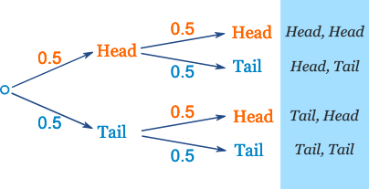
We can depict the sample space in a few ways: list, table, tree
For two coin flips:
List: HH, HT, TH, TT
Table:
Tree:
 | H | T
H | HH | HT
T | TH | TT
https://www.mathsisfun.com/data/probability-tree-diagrams.html

Slide 29
Now we can return to the Axioms of Probability more formally
Axiom 1: For any event E, P(E) ≥ 0
Axiom 2: If S={the whole sample space}, then P(S) = 1
Axiom 3: if E1 and E2 are mutually exclusive, then
P(E1∪E2) = P(E1) + P(E2)

Slide 30
We can combine the axioms in different ways to build further laws/constraints
Axiom 1: For any event E, P(E) ≥ 0
Axiom 2: If S={the whole sample space}, then P(S) = 1
Given Axioms 1 and 2, what are the bounds of probability on any given event E?
0 ≤ P(E) ≤ 1

Slide 31
A subset is, well, a set S₁ whose elements all are also found in another set S₂
Denoted with the symbol ⊆, e.g. S₁ ⊆ S₂
“S₁ is a subset of S₂”
Examples:
{1, 2, 3} ⊆ {1, 2, 3, 4, 5, 6}
S ⊆ S (every set is a subset of itself)
{5, 6, 7} ⊈ {1, 2, 3, 4, 5, 6} (every element in S1 must be in S2)

Slide 32
If E₁ ⊆ E₂, what can we say about P(E₁) and P(E₂)?
Answer: P(E₁) ≤ P(E₂)
Every possible outcome in E1 is also in E2, so there’s no way that E1 is more likely than E2

Slide 33
There are also proper subsets, denoted S₁ ⊂ S₂
S₁ ⊂ S₂ if S₁ contains only elements from S₂ but not all of them
Examples are these true?:
{heads} ⊂ {heads, tails} ?
S ⊂ S for any set S ?
Yes
No

Slide 34
The complement of an event is the outcome in which that event does not occur
Denoted with a “C” superscript: E^{C} is the complement of E
I.e. every event in the sample space except E
For example:
Coin flip: {heads}^{C} =
Dice roll: {1, 2, 3, 4}^{C} =
Thermometer reading: {≤40°F}^{C} =
{tails}
{5, 6}
{>40°F}

Slide 35
What is the probability of E^{C} in terms of the probability of E?
P(E^{c}) = 1 – P(E). Let’s prove that formally using the 3 axioms:
Note that E^{C} ∪ E = {the sample space}
By Axiom 2, we know that P(the sample space) = 1
E^{c} and E are mutually exclusive, so by Axiom 3 we have that P(E^{C} ∪ E) = P(E^{C}) + P(E)
Therefore, 1 = P(E^{C} ∪ E) = P(E^{C}) + P(E) ⇒ P(E^{c}) = 1 – P(E)
Q.E.D. (quod erat demonstrandum = “which was to be demonstrated” = ✅)

Slide 36
What is the probability of E^{C} in terms of the probability of E?
We won’t be doing more proofs like that...but I wanted to give a taste of the more formal/mathematical approach to all of this
For those of you (like me) who find that interesting ☺

Slide 37
Conditional probability is the probability that X occurs given that Y has occurred
Denoted with a vertical bar: P(X|Y)
“Probability of X given Y”
2 consecutive coin flips. Sample space is: {HH, HT, TH, TT}
P(HH) = ¼
P(HH | H on first flip) =
P(HH | T on first flip) =
½
0

Slide 38
Conditional probability is the probability that X occurs given that Y has occurred
Another way of thinking about it P(X|Y): Assume Y has occurred. In that case, what’s the probability of X?
For example:
P(E | E) = 1 (if something happened, it’s certain that it happened)
P(E | E^{c}) = 0 (if something didn’t happen, it’s impossible that it did happen)

Slide 39
Conditional probability is the probability that X occurs given that Y has occurred
Suppose a day is randomly drawn from the Central Park dataset. Consider the probability that its temp_avg is >80°F.
Let’s denote this P(hot day).
Rank the following from smallest to largest:
a) P(hot day)
b) P(hot day | the day is in January)
c) P(hot day | the day is in July)
b < a < c

Slide 40
Conditional probability is the probability that X occurs given that Y has occurred
Formally: P(X|Y) = P(X∩Y) / P(Y)
Probability of both X and Y occurring divided by
the unconditional probability of Y occurring
Return to 2 consecutive coin flips:
P(HH | H on 1st flip) = P(HH & H 1st flip) / P(H 1st flip)
= 0.25 / 0.5 = 0.5
P(HH | T on 1st flip) = P(HH & T 1st flip) / P(T 1st flip)
= 0 / 0.5 = 0

Slide 41
Independent events are, well, events that do not depend on one another
Are consecutive coin flips or dice rolls independent events?
Yes!
The outcome of the previous roll or flip has no influence on the outcome of the next one.

Slide 42
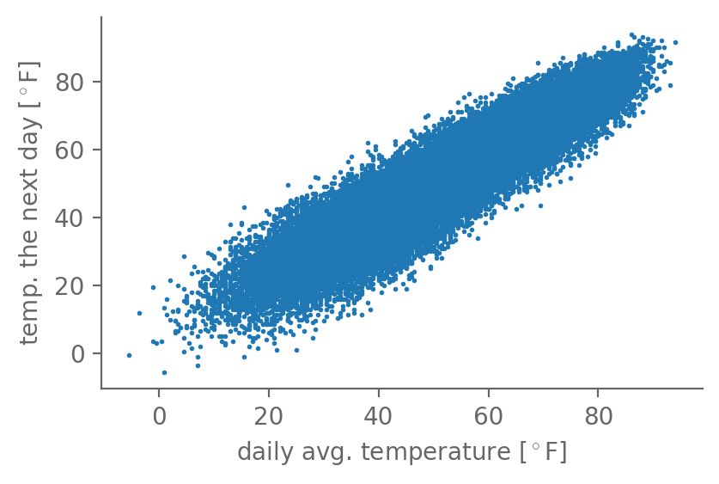
Independent events are, well, events that do not depend on one another
Is {hot day} independent of
{hot day the day before}?
Recall this graph:
No. If you know yesterday was hot, you can be more confident that today will be hot than if you didn’t know anything about yesterday’s weather

Slide 43
If X and Y are independent, what are the conditional probabilities P(X|Y) and P(Y|X)?
In terms of the unconditional probabilities P(X) and P(Y)
If X and Y are independent, then Y is not influenced by X, and vice versa, so knowing one doesn’t help knowing the other
I.e. P(X|Y) = P(X) and P(Y|X) = P(Y) if X and Y are independent
A silly example to hopefully drive the point home: consider P(roll a 4 | the number of hairs on your head is even)

Slide 44
Joint probability is the probability of two events, E₁ and E₂, both occurring
Denoted P(E₁, E₂)
“the joint probability of E₁ and E₂”
This is just another way of saying the probability of their intersection: P(E₁, E₂) = P(E₁ ∩ E₂)
And I’d say people refer to it as “joint probability” more often

Slide 45
Joint probability is the probability of two events, E₁ and E₂, both occurring
If two events are independent: P(E₁, E₂) = P(E₁) ✖️ P(E₂)
I.e. multiply their two probabilities
E.g. P(H 1st flip, H 2nd flip) = P(H 1st flip) ✖️ P(H 2nd flip)
= 0.5 ✖️ 0.5 = 0.25
And P(H 10 times in a row) = (½)¹⁰ ≈ 0.001

Slide 46
What is the probability of the union of two events E1 and E2?
Intuitively, what is: P({roll is even} ∪ {roll > 3})?
A: 2/3: 2, 4, 5 and 6 are all either even or >3
So that’s 1/6 + 1/6 + 1/6 + 1/6 = 2/3
Q: Why isn’t it P(roll is even) + P(roll > 3) = ½ + ½ = 1?
A: The two events aren’t mutually exclusive! (Recall Axiom 3)
Summing their probabilities “double counts” their intersection, which is {4,6}

Slide 47
We can capture many of the concepts so far by representing the sample space graphically
E₁
E₁ ∩ E₂
E₂
The sample space S is represented by the rectangle
The probability of each event equals its area as a fraction of S
Are E₁ and E₂ mutually exclusive?
Is P(E1) > P(E2)?
No
Yes
(the whole rectangle): S

Slide 48
We can capture many of the concepts so far by representing the sample space graphically
(the whole rectangle): S

Slide 49
We can capture many of the concepts so far by representing the sample space graphically
E₁
S

Slide 50
We can capture many of the concepts so far by representing the sample space graphically
E₁
E₁^{C}
S

Slide 51
We can capture many of the concepts so far by representing the sample space graphically
E₂
S

Slide 52
We can capture many of the concepts so far by representing the sample space graphically
E₂^{C}
E₂
S

Slide 53
We can capture many of the concepts so far by representing the sample space graphically
E₁
E₁ ∩ E₂
E₂
S

Slide 54
We can capture many of the concepts so far by representing the sample space graphically
E₁ ∪ E₂
S

Slide 55
We can capture many of the concepts so far by representing the sample space graphically
(E₁ ∪ E₂)^{C}
S

Slide 56
We can capture many of the concepts so far by representing the sample space graphically
E₁
E₁ ∩ E₂
E₂
Probability of the union: graphically, it’s clear that:
P(E₁ ∪ E2) = P(E₁) + P(E₂)
- P(E₁ ∩ E₂)
S

Slide 57
We can capture many of the concepts so far by representing the sample space graphically
E₁
E₁ ∩ E₂
E₂
Conditional probability: P(E₁ | E₂). Effectively, the sample space becomes E₂: S’=E₂
E₂ happened, so E₂^{C} didn’t.
S

Slide 58
We can capture many of the concepts so far by representing the sample space graphically
E₁ ∩ E₂
E₂
Conditional probability: P(E₁ | E₂). Effectively, the sample space becomes E₂: S’=E₂
E₂ happened, so E₂^{C} didn’t.
Graphically, then, it’s clear that:
P(E₁ | E₂) = P(E₁ ∩ E₂) / P(E₂)
S’

Slide 59






Let’s return graphically to the dice roll 🎲 example of {even} ∪ {>3}
One small rectangle per event; sample space = outer rectangle
1
2
3
4
5
6
https://www.iconfinder.com/icons/2336042/dice_dice_roll_dice_roll_6_dice_roll_six_die_six_white_dice_icon

Slide 60
Let’s return graphically to the dice roll 🎲 example of {even} ∪ {>3}
Start with {roll is even}: clearly 3/6=1/2
1
2
3
4
5
6

Slide 61
Let’s return graphically to the dice roll 🎲 example of {even} ∪ {>3}
Next: {roll > 3}: again, 3/6=1/2
1
2
3
4
5
6

Slide 62
Let’s return graphically to the dice roll 🎲 example of {even} ∪ {>3}
Their intersection: {even} ∩ {>3}: 2/6=1/3
1
2
3
4
5
6

Slide 63
Let’s return graphically to the dice roll 🎲 example of {even} ∪ {>3}
Together: {even}, {>3}, and {even} ∩ {>3}: 4/6=2/3
1
2
3
4
5
6

Slide 64
Let’s return graphically to the dice roll 🎲 example of {even} ∪ {>3}
Their union: {even} ∪ {>3}: 4/6=2/3
1
2
3
4
5
6

Slide 65
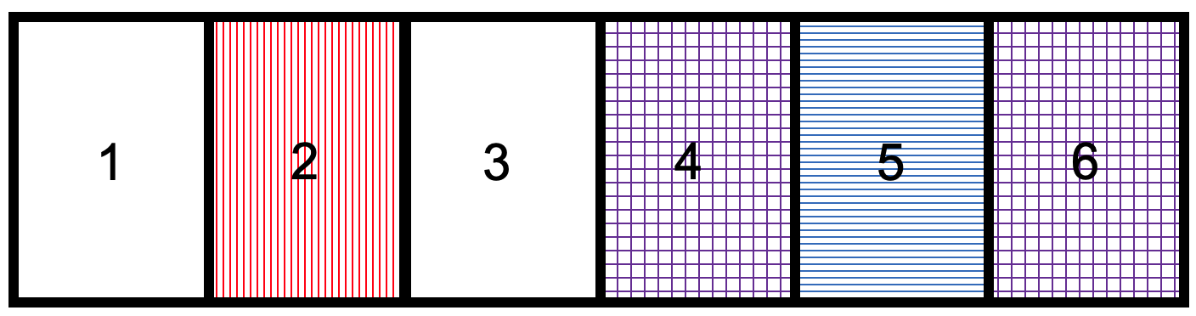
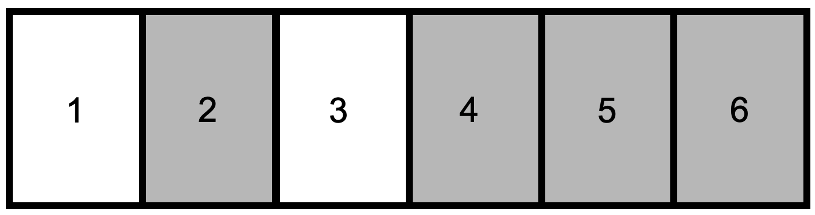
Let’s return graphically to the dice roll 🎲 example of {even} ∪ {>3}
So P(E1∪E2) =
P(E1)+P(E2)-P(E1∩E2)
Must subtract their intersection, otherwise it’s double counting

Slide 66
What we’re covering today:
The Three Axioms of Probability intuitively ✅
Probability formally: sets, events, unions, intersections, subsets, complements, sample spaces, independence, etc. ✅
Probability philosophically: frequentist v. Bayesian interpretations; what ”unconditional” probability means
Probability distributions: empirical CDFs and PDFs

Slide 67
There are two main ways to interpret probabilities: frequentist and Bayesian
The Axioms of Probability tell us how to calculate probabilities, but they don’t tell us what probabilities mean
The frequentist and Bayesian interpretations each provide their own---quite different---answers to that question
But both give identical mathematical results!

Slide 68
The frequentist approach takes probabilities to be the limit of n identical trials as n→∞
Consider the coin flip. We intuitively know that P(H)=P(T)=1/2.
So does that mean that if I flip a coin and get heads, the next time I’ll get tails?
No: each flip is independent.
But then how can we say that P(H) = ½ if
I can get 2 tails in a row (or even more)?

Slide 69
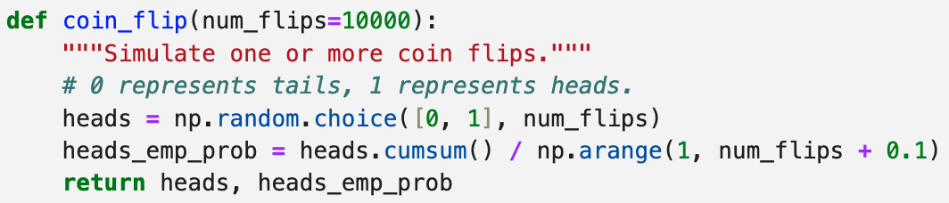
The frequentist approach takes probabilities to be the limit of n identical trials as n→∞
Suppose I do 10 flips (n=10). Or 100 (n=100). Or one million (n=10⁶).

Slide 70
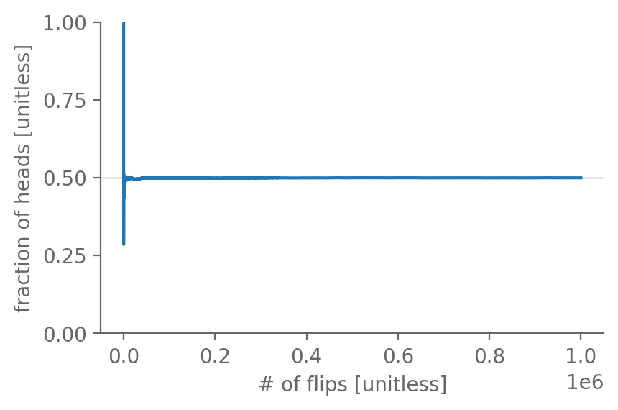
The frequentist approach takes probabilities to be the limit of n identical trials as n→∞
Suppose I do 10 flips (n=10). Or 100 (n=100). Or one million (n=10⁶).
How do you expect the fraction of heads to change as n increases?

Slide 71
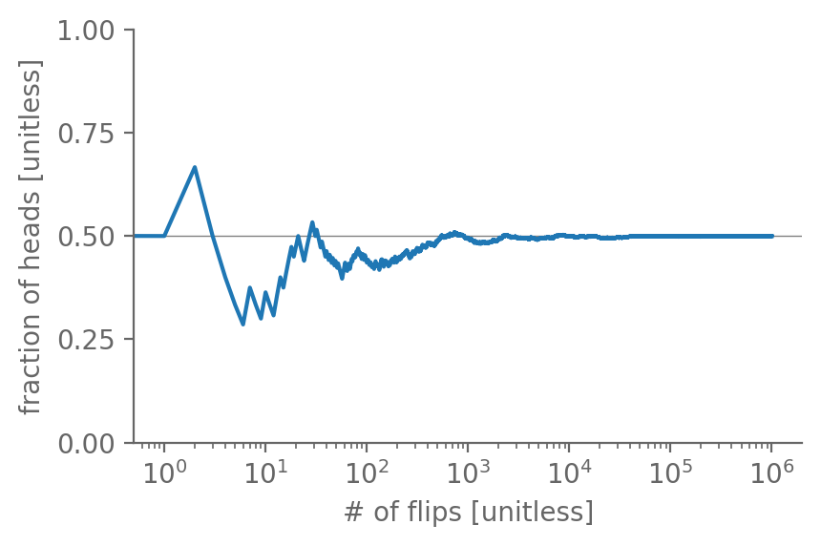
The frequentist approach takes probabilities to be the limit of n identical trials as n→∞
Suppose I do 10 flips (n=10). Or 100 (n=100). Or one million (n=10⁶).
How do you expect the fraction of heads to change as n increases?

Slide 72
The frequentist approach takes probabilities to be the limit of n identical trials as n→∞
But how to apply this frequentist approach when we don’t have infinitely many identical trials?
E.g. P(Central Park daily rain ≥ 5.48”)?
The most straightforward approach is to use the empirical frequencies: treat each of your observations as an event
And all of the observations as your sample space

Slide 73
The frequentist approach takes probabilities to be the limit of n identical trials as n→∞
https://www.weather.gov/wrh/Climate?wfo=okx
How likely was this? How would we estimate that?
To start, ignore seasonality, long-term trends, etc.

Slide 74
The frequentist approach takes probabilities to be the limit of n identical trials as n→∞
https://www.weather.gov/wrh/Climate?wfo=okx
# days total: 56,520. # days with >= 5.48” rain: 9
So 9 / 56520 = 0.00016. I.e. 0.016% chance by this measure!

Slide 75
Using empirical frequencies works best when # data points is large
Suppose we only had 1 year’s worth of data, i.e. 365 days. What’s the lowest nonzero empiricial probability we could get?
Answer: 1 / 365 ≈ 0.27%
So from those observations alone, there’s very little we could say about the probabilities of events that occur (on average) less frequently than once per year. (e.g. a “20-year storm”)

Slide 76
Using empirical frequencies works best when # data points is large
How to get around this? We fit a parametric distribution to the dataset, and use that to extrapolate beyond the data points
Which we’ll cover soon!

Slide 77
Using empirical frequencies works best when the system is stationary
Is each day in our dataset truly independent from the others?
No. For example, recall P(hot day | July) > P(hot day | January)
In addition to seasonal cycle, there’s the long-term warming.
So presumably P(hot day | 1870s) < P(hot day | 2010s)

Slide 78
Using empirical frequencies works best when the system is stationary
That said, empirical frequencies are almost always a useful starting place
And later we’ll introduce techniques for correcting for seasonality, long-term trends, etc.

Slide 79
We won’t cover Bayesian statistics much beyond today, but they’re important!
Aside from things like dice rolls and coin flips, for most things it’s not plausible to construct multiple quasi-identical repeated trials
Let alone an infinity of them!
In that way, arguably the Bayesian approach is the more “realistic” one of the two. But it’s also more complicated!
And less intuitive. So in this class we’ll stick w/ frequentist.

Slide 80

The Bayesian approach essentially asks: at what odds what you accept a bet?
For many things we want to know the probabilities of, we don’t have anything close to a large number of identical samples
E.g. P(Kansas City Chiefs win this Sunday).

Slide 81
The Bayesian approach essentially asks: at what odds what you accept a bet?
If you’d accept $1-to-$9 (=you win $1 if Chiefs win, you lose $9 if Chiefs lose), then you’re basically taking P≥90%
Why? If, for example, they’re 91% likely to win, then you have a 91% chance of gaining $1 vs. a 9% chance of losing $9
So your expected value is $1 * 91% + (-$9) * 9% = +$0.10
I.e. you stand to make $! (We’ll define expected value later.)

Slide 82
Key to Bayesian statistics are your priors, i.e. what you know & believe going in
Let’s suppose you know absolutely nothing about football or the Kansas City Chiefs.
Then you have no possible way of thinking that it’s more likely that they’ll win vs. that they’ll lose.
So your probability is that of the base rate: 50-50.

Slide 83
Key to Bayesian statistics are your priors, i.e. what you know & believe going in
Now let’s suppose that you know that they are one of the best teams in the league and are playing against one of the worst teams in the league.
Both are true this week! ☺
Based on that information alone, you can update your priors: it’s now more likely than before that they’ll win.

Slide 84
Key to Bayesian statistics are your priors, i.e. what you know & believe going in
An Earth science example: to know e.g. P(rain > 1” any day in November), the base rate would just be the empirical probability of that occurring across all years of our dataset
Then if you knew that, say, the ongoing El Nino conditions in the equatorial Pacific made rain more likely: update your priors

Slide 85
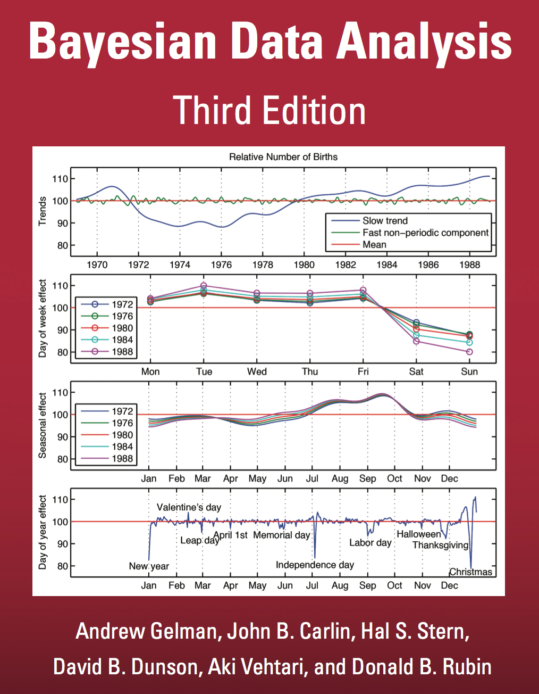
We won’t cover Bayesian statistics much beyond today, but they’re important!
FREE textbook on Bayesian statistics: http://www.stat.columbia.edu/~gelman/book/

Slide 86
In some meaningful (albeit philosophical) sense, unconditional probability is misleading
In other words, probability inherently depends on what we know
In line w/ the Bayesian perspective
Consider a coin flip…P(heads) = P(tails) = 0.5 right?
Aren’t those the unconditional probabilities?

Slide 87
In some meaningful (albeit philosophical) sense, unconditional probability is misleading
Consider a coin flip…P(heads) = P(tails) = 0.5 right?
The coin flip is governed by the laws of physics
And we live in a deterministic (enough) universe
So if we knew the initial and boundary conditions of the coin flip well enough, we could predict how it lands with 100% accuracy
Coin flip machine: https://youtu.be/8XX0iRAN--8?t=358

Slide 88
In some meaningful (albeit philosophical) sense, unconditional probability is misleading
In that case, we would have either P(heads)=100, P(tails)=0
Or vice versa, depending on the conditions for that particular flip
So in that case, P(heads) is really shorthand for
P(heads┃{the initial & boundary conditions we know precisely})
Whereas the “normal case” is:
P(heads┃{not knowing those conditions}) = 0.5

Slide 89
In some meaningful (albeit philosophical) sense, unconditional probability is misleading
One more example: I have defined another Python function to simulate a single coin flip: coin_flip2
What is your P(heads) when I call coin_flip2 ? 0.5 right?
What is my P(heads)?

Slide 90
In some meaningful (albeit philosophical) sense, unconditional probability is misleading
What is my P(heads)? 100%! Why? Because I coded it to always return heads:
def coin_flip2():
return “Heads”
So for you, P(heads) was really:
P(heads┃I trust that the prof. isn’t scamming us)

Slide 91
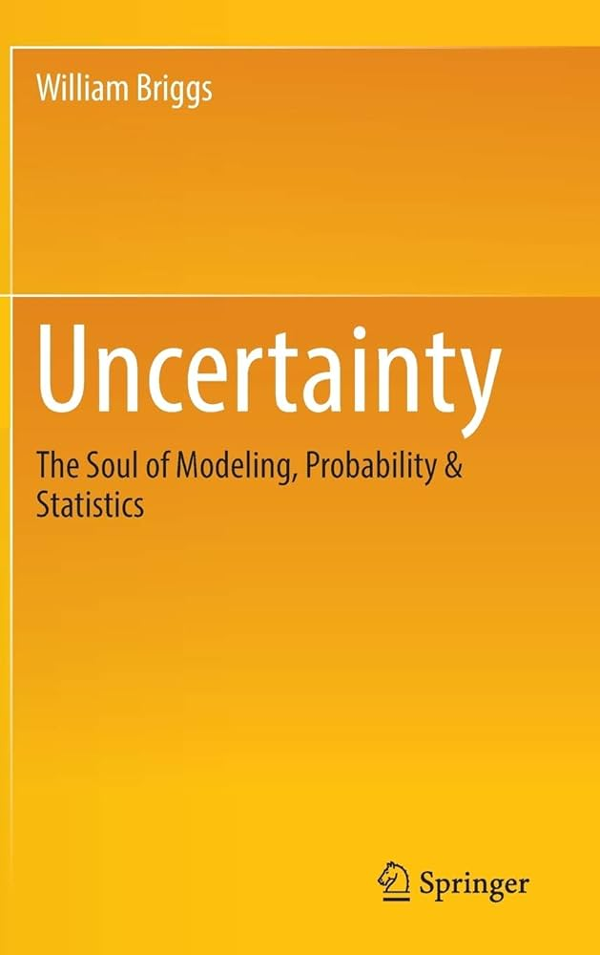
In some meaningful (albeit philosophical) sense, unconditional probability is misleading
That all said, moving forward, we’ll still use unconditional probabilities
Just keep this philosophical caveat in the back of your mind
And you will NOT be tested/graded on it
For more: Uncertainty by William Briggs
https://www.amazon.com/Uncertainty-Soul-Modeling-Probability-Statistics/dp/3319397559

Slide 92
What we’re covering today:
The Three Axioms of Probability intuitively ✅
Probability formally: sets, events, unions, intersections, subsets, complements, sample spaces, independence, etc. ✅
Probability philosophically: frequentist v. Bayesian interpretations; what ”unconditional” probability means ✅
Probability distributions: empirical CDFs and PDFs

Slide 93
The cumulative distribution function (CDF) of X gives P(X≤x) for every possible x
How to construct the empirical CDF:
Sort all your values from lowest (x_{min}) to highest (x_{max})
For each value x from x_{min} to x_{max}, compute the # of values that are ≤ x, and divide by the total # of values.
In practice: use scipy.stats.ecdf

Slide 94
The cumulative distribution function (CDF) of X gives P(X≤x) for every possible x
In other words, it tells what quantile the given value of x is
Recall: N^{th} quantile = value such that N fraction of the data is equal to or less than that value, and (1-N) fraction is above

Slide 95
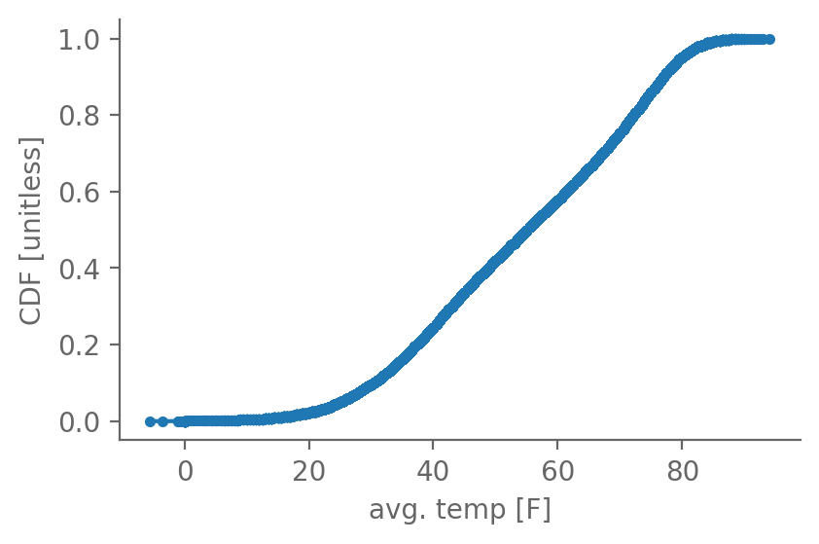
The cumulative distribution function (CDF) of X gives P(X≤x) for every possible x
Central Park
temperature:

Slide 96
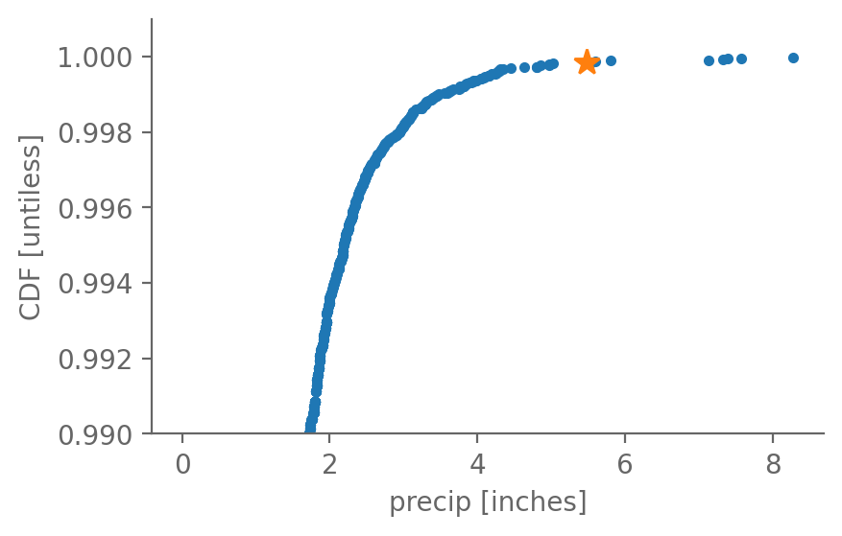
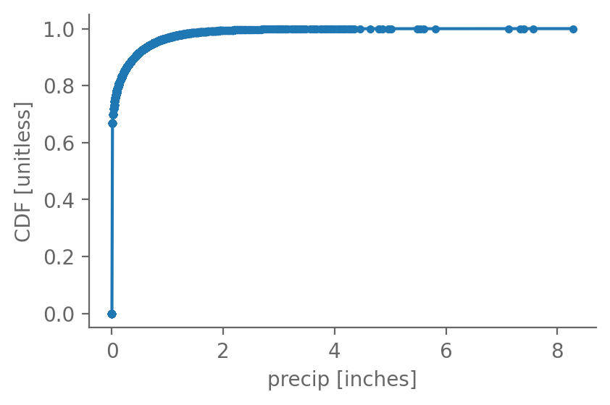
The cumulative distribution function (CDF) of X gives P(X≤x) for every possible x
Central Park precipitation:
zoom in

Slide 97
The probability density function (PDF) of X gives P(x₁< X< x₂) for a given x₁ and x₂
For empirical distributions, the PDF is in essence the derivative of the CDF: PDF(X) ~ d(CDF(X)/dX
In essence because the empirical CDF is discrete and thus not continuous: its derivative is not well defined
Whereas for parametric distributions, which are continuous, this is exactly true: PDF(X) ≡ d(CDF(X)/dX)

Slide 98
The probability density function (PDF) of X gives P(x₁< X< x₂) for a given x₁ and x₂
We approximate the PDF using histograms:
Chunk the whole distribution into x₁, x₂, …, x_{N}
Count the # of values between x₁ and x₂, x₂ and x₃, etc.
Divide each count by the width of that bin: x₂ – x₁, x₃ - x₁, etc.

Slide 99
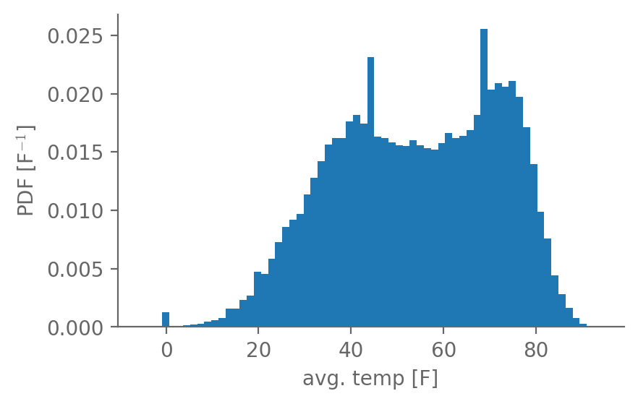
The probability density function (PDF) of X gives P(x₁< X< x₂) for a given x₁ and x₂
Central Park temperature:

